Slide 1
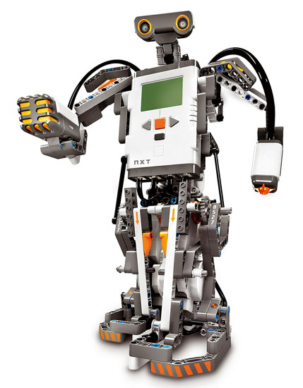
Cognitive Approach to Robot Spatial Mapping
Ghislain Fouodji Tasse
Supervisor: Dr. Karen Bradshaw
Computer Science Department
Rhodes University
24 March 2009

Slide 2
DEFINITIONS
Cognitive science is the study of the nature of intelligence.
Spatial mapping means modelling the environment into a map.
View based map uses different pictures of the space and their relative distances (human beings perception).
Shape based map uses a mathematical modelling, meaning that the map is basically a collection of geometrical coordinates.

Slide 3
PROBLEM STATEMENT
Collection of data: the robot should be able to record the positions of different items in its surroundings.
Data Integrity: we have to check the validity and consistency of the data.
Interpretation of data: the robot should be able to interpret the data to ensure that it makes sense.
Result to a map: the data is then converted to a map using the appropriate model.
Usage of the map: the robot should be able to use the map to navigate through space.

Slide 4
HOW ? (METHODOLOGY)
Sensors: range sensors are the typical tools used to record data.
Self localisation: data is meaningful only if it is associated with a proper frame of reference.
Position tracking: the data of a new state is relative to the data of the previous state.
Shape based model is used to interpret our data and produce a map.
The map is then used by the robot as a set of rules to be applied when responding to a user’s request.

Slide 5
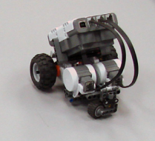
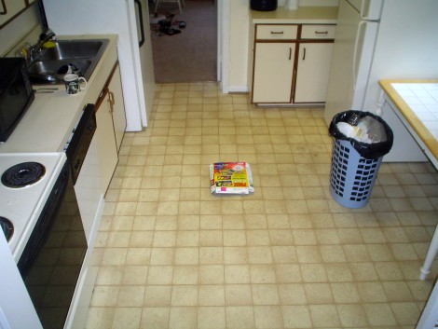
ILLUSTRATION (Indoor Environment)
+
=

Slide 6
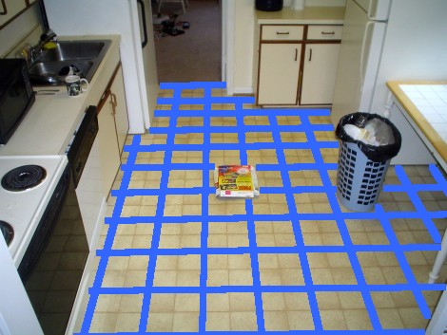
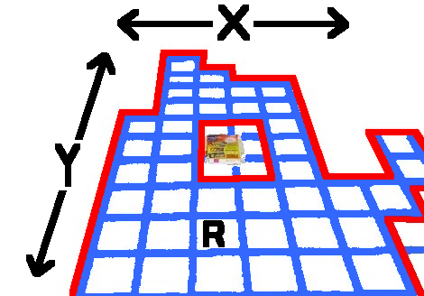
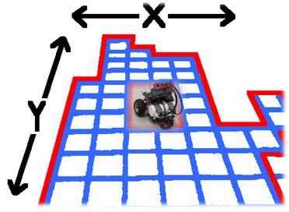
ILLUSTRATION(Grid Occupancy)
→
→
→
→

Slide 7
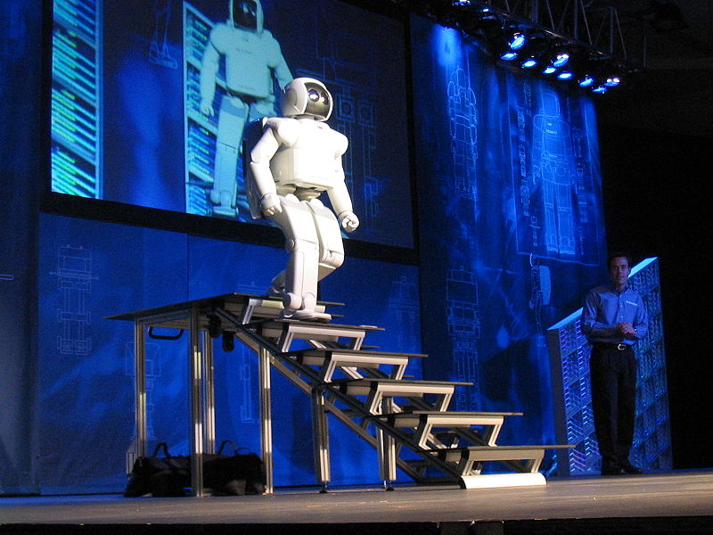
EXPECTED RESULTS
Our robot maps a sample environment in a reasonable time.
Our robot is able to perform an autonomous navigation using its own map.
The robot navigation is collision free.
The map is flexible. Our robot can adapt its map to any change in the environment.
Map optimization is always possible.

Slide 8
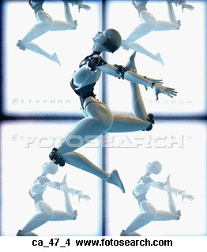
POSSIBLE EXTENSIONS
This research is a first step and can be extended to achieve complete and optimal self navigation with free collision in the real world by a robot.
The concept of cognition could be extended to other area in robotics such as natural language processing.

Slide 9
?

